Slide 1

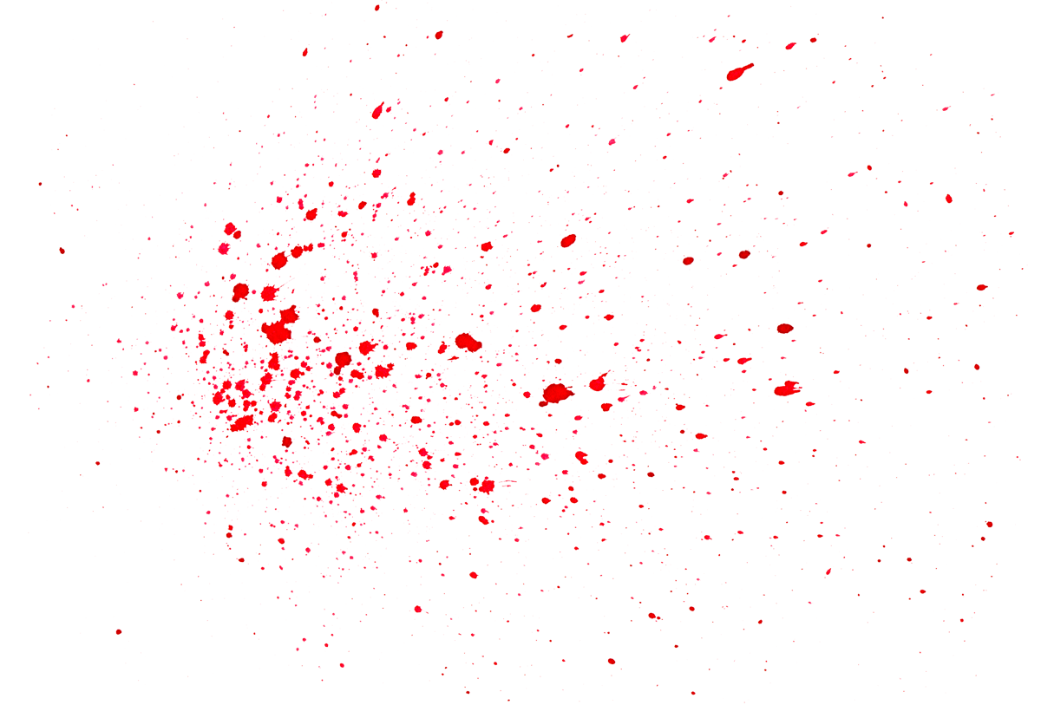


FBI Homicide Cases 1980-2014
BY: Carmi Smith
Brittany Schultz
Mandy Farrell Chad Milburn

Slide 2

Our Agenda: The following questions were asked when we were collecting our data.
Does the murder count over the years increase or decreased? ?
Who are you more likely to be killed by??
What gender is more likely to get away with a murder? ?
What weapon is more likely to be used?
How does Age, Gender, Location and Income effect the murder? ?

Slide 3

Data Preparation and Cleaning
Data was cleaned utilizing Python and several libraries
Pandas
NumPy
Matplotlib
Matplotlib provided good visuals, but the quality and additional features provided by Tableau were much better

Slide 4

Data Limitations
Census Data only covered each decade in a group not by each year.
FBI City Data was listed as county data.
FBI Records was incomplete or under reported for part of the 90’s
Several Records with solved cases were missing demographic data

Slide 5

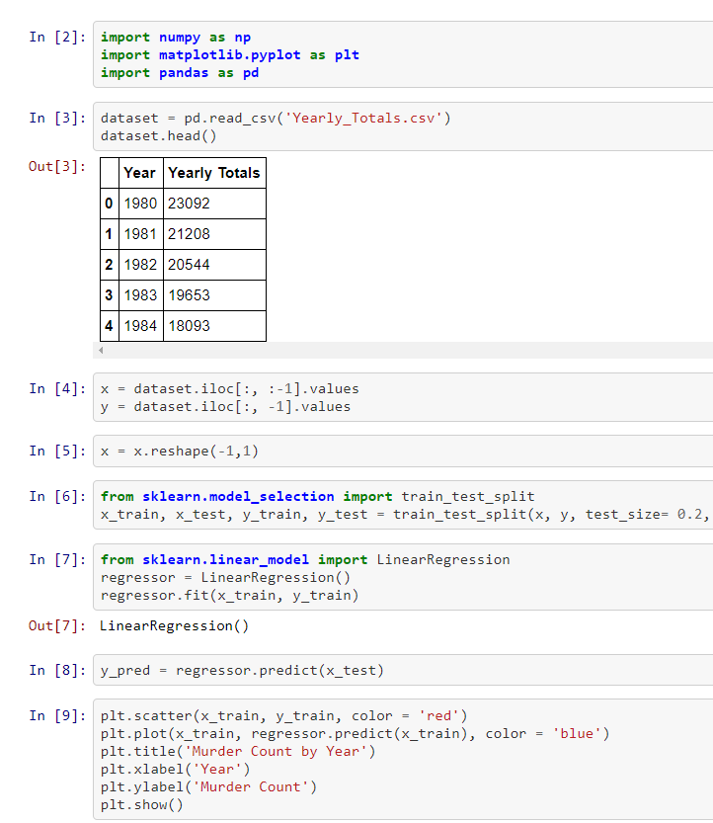
Machine Learning Code

Slide 6

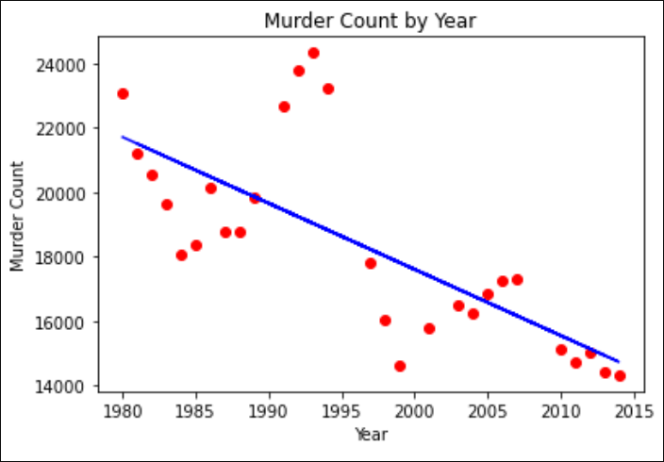
Data Collection
Scatter Plot by Machine Learning:
FBI Homicide Records provided by Data World
Census Data collected from Wikipedia US Population Data
Education Data provided by Kaggle
As you can see on the chart shown here. The amount of murders reported from 1980 to 2014 has consistently decreased.
Although we did discover a few outliers in the 90s due to the Rodney King Riots and Oklahoma bombing
Notes:
Mandy for update on the location education data was collected

Slide 7


After reviewing the data, it shows that you are more likely to be killed by an acquaintance than anyone else. A Strange ranks next, then husband with a close runner-up of friend. .
Perpetrator, Who Did It?

Slide 8


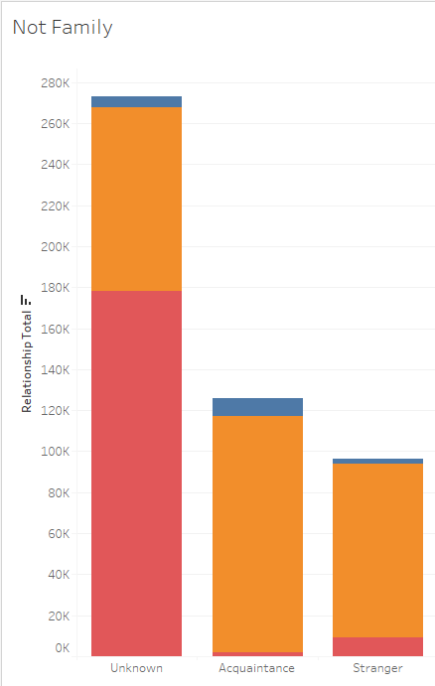
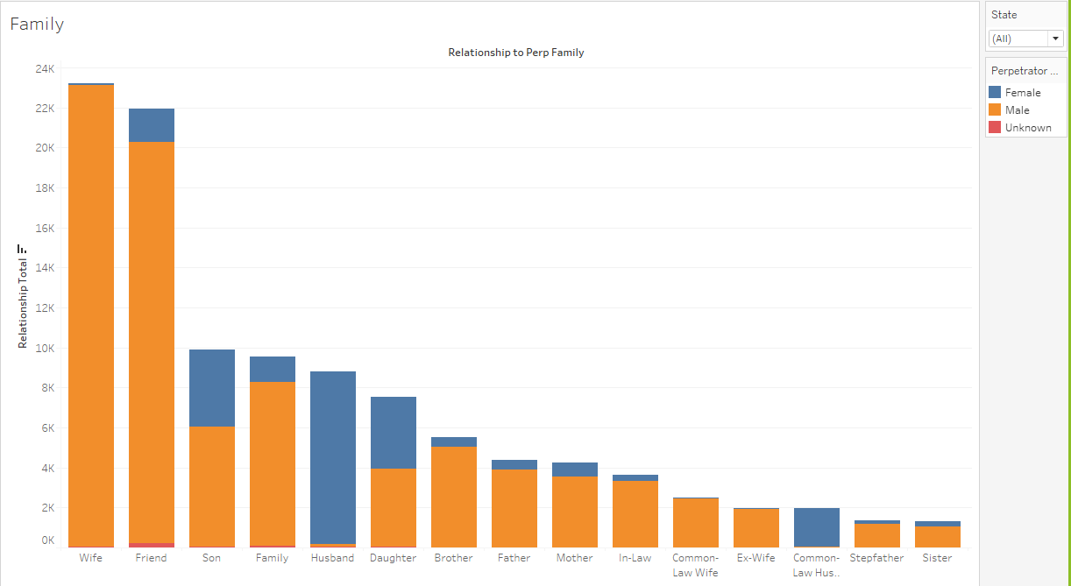
Perpetrator by Relationship to Victim
Victim
Notes:
The Acquaintance victim category is approximately 125K. The Strange is next at approximately 95k. Then the Wife is at approximately 23.5k and then a Friend at approximately 20K . The next categories drop to approximately 10k which is the Son and Extend Family. The lowest victim category is a Stepfather, Sister and Stepson at approximately 2k

Slide 9

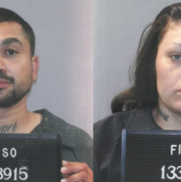

Who is more likely to get away with a murder?
As shown on the date: Males are more likely to commit a murder and get caught than females
Notes:
The Acquaintance victim category is approximately 125K. The Strange is next at approximately 95k. Then the Wife is at approximately 23.5k and then a Friend at approximately 20K . The next categories drop to approximately 10k which is the Son and Extend Family. The lowest victim category is a Stepfather, Sister and Stepson at approximately 2k

Slide 10

What weapon was used the most per age group?
Children under the age of 18 are more likely to be murdered by drowning.
The average Victim age range is 30 to 40 years old with a wide range of weapons used
The Perps under the age of 20 are more likely to use a firearms, explosives or strangulation for a weapon.
The average Perp age range is 20 to 30 years old with a wide range of weapon used.
After the age of 50, your risk of being murdered is decreased but you have a wider range of weapons used.

Slide 11


Chosen Weapon by Gender
Firearms are the highest chosen weapon by both genders with Males in the lead.
Knives are the second highest chosen weapon by both genders with Males in the lead.
Blunt Objects are the third highest
chosen weapon
Unknown is the fourth highest chosen weapon
The other weapons are list in descending order: Strangulation, Fire, Suffocation, Drugs, Drowning and Falls

Slide 12

Time for Questions…
Sources for FBI Homicide Cases Project
Credits go to:
https://www.kaggle.com/murderaccountability/homicide-reports
https://www.census.gov/topics/income-poverty/income/data
Link to Tableau project:
https://public.tableau.com/profile/mandy.farrell8616#!/

Slide 13
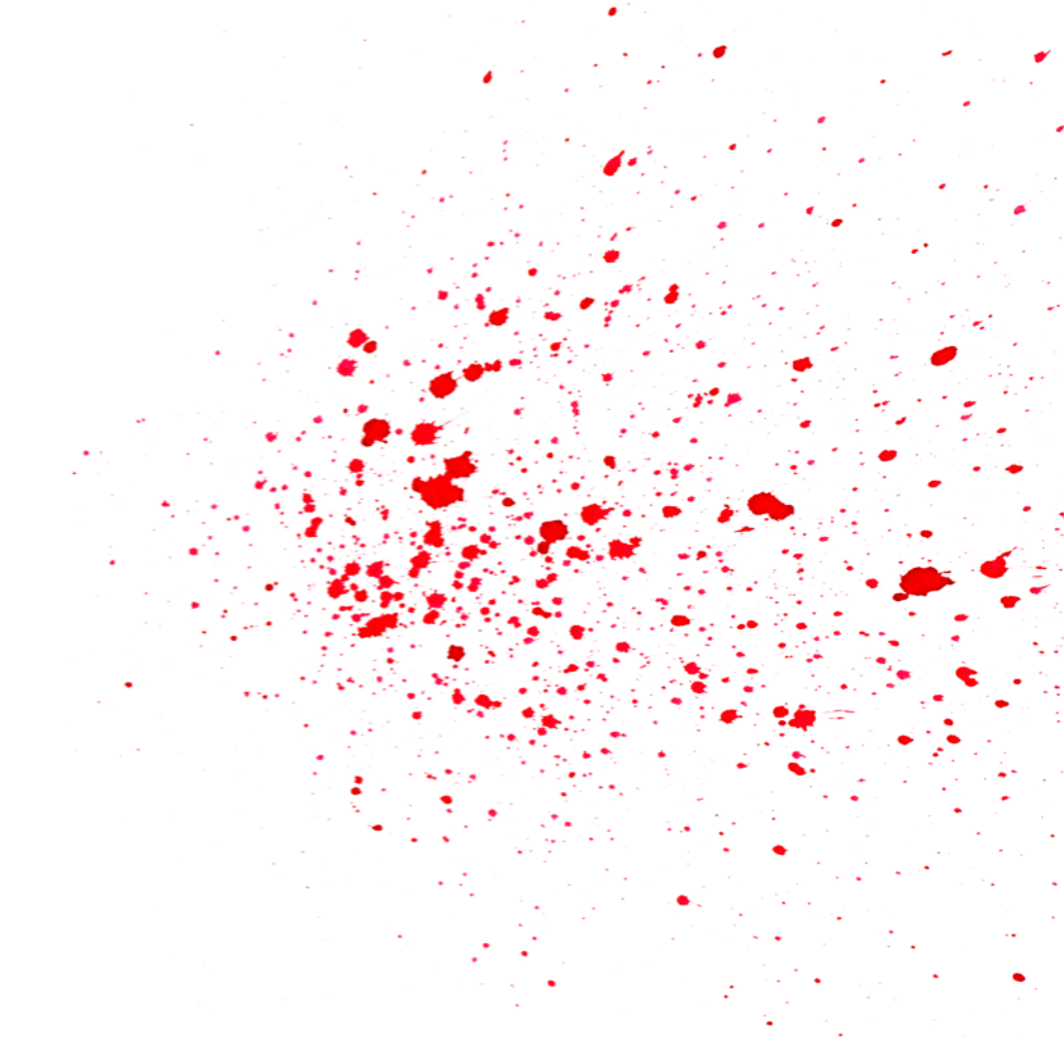
See you around…..

